Slide 1
Reinforcing Software Engineering Learning Through Provenance
Troy C. Kohwalter
Esteban W. G. Clua, Leonardo G. P. Murta
Instituto de Computação – Universidade Federal Fluminense (UFF)

Slide 2

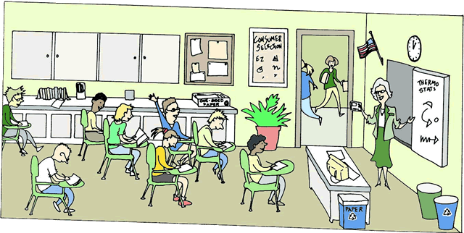
Motivation
Theoretical Classes
Knowledge
Practical Work
Competence
Know how to
Performance
Show how to
Notes:
Explain the motivation for using Serious Games

Slide 3

Motivation
Games
Fun
Enjoyment
Involving
Play
Motivating
Goals
Learning
Feedback
Notes:
Explain why Serious Games works

Slide 4

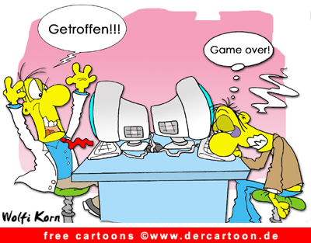
Motivation
Bloody Hell! Why did this happen!?
How!
Why!?
Impossible!!!
What have I done wrong?
Did I make a mistake?
Notes:
Explain the problem of analyzing the game outcome

Slide 5

Motivation
Game Outcome
Derived from Decisions and Actions
Cause-and-Effect
How to analyze it?
Retry the game?
Trial-and-Error approach?
Notes:
Explain the problem of analyzing the game outcome
Solution: Provenance

Slide 6
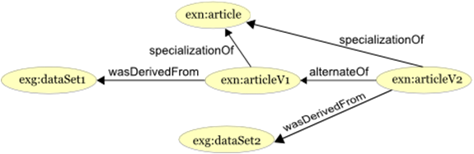
Provenance
“Refers to the documented history of an art object, or the documentation of processes in a digital object’s life cycle”
Provenance Graph
Causality Graph
Agents
Entities
Activities
Provenance Models
OPM (2007)
PROV (2010)
http://www.w3.org/TR/prov-primer/
Notes:
Provenance
By its definition, Provenance refers to the documented history of an art object or the documentation of processes in a digital object’s life cycle
It uses a provenance graph to display the provenance information, which is a directed graph representing the causality relationships between the entities involved.
Currently there are two provenance models: the Open Provenance Model and PROV. This work is based on the PROV notation.

Slide 7


Goal
Evaluate Game Provenance for:
Game Analysis
More efficient?
More effective?
Aiding Students
Understand underlying reasons
Notes:
The goal of this paper is to evaluate if the use of provenance during a game analysis aids students to understand the underlying reasons for the game outcome.
The goals of these experiments were to know if the provenance analysis is more efficient and effective than analyzing the game by re-watching the session, trying to observe if it has a higher identification rate of the cause-and-effect relations between the actions and their outcomes.

Slide 8

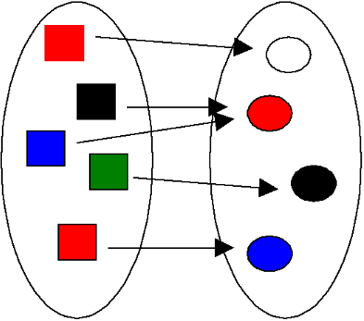
Previous Work
Provenance in Games
Conceptual Framework
Map Domains
Provenance to Games
Gather
Provenance Information
Causal Relationships
Notes:
In our previous work, we presented a conceptual framework called Provenance in Games, which maps elements from the provenance domain to games domain and also allows for gathering provenance information from a game session

Slide 9

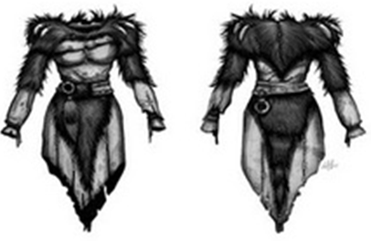
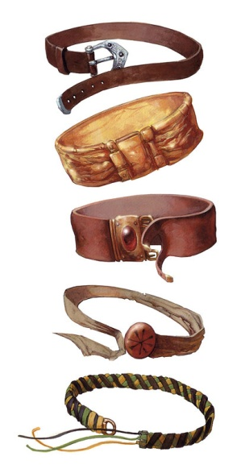
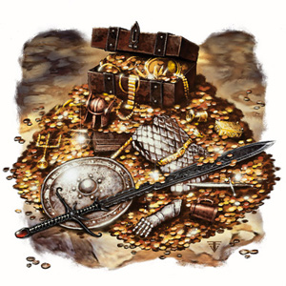

Provenance Gathering
Entity
Objects
Activity
Actions
Events
Agent
NPCs
Player
Notes:
This is the mapping from provenance to games.
Entities were mapped to inanimate game objects

Slide 10
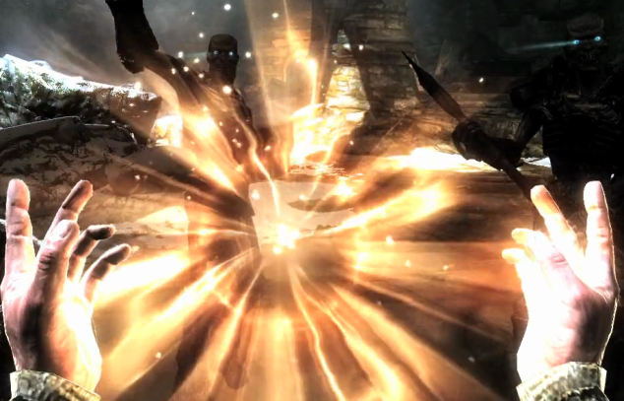


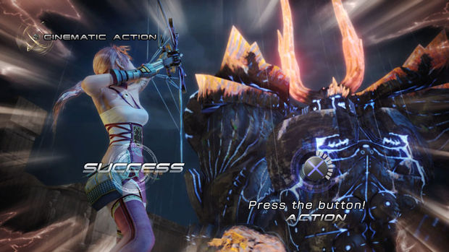
Provenance Gathering
Entity
Objects
Activity
Actions
Events
Agent
NPCs
Player
Notes:
Activities to actions and events

Slide 11

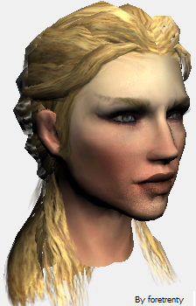


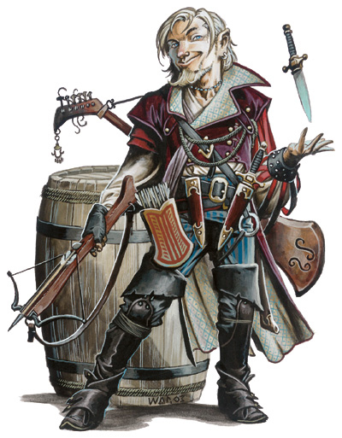
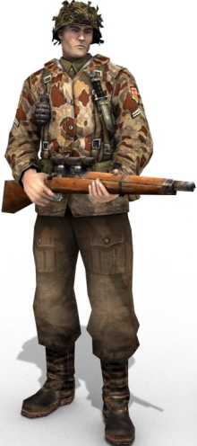

Provenance Gathering
Entity
Objects
Activity
Actions
Events
Agent
NPCs
Player
Notes:
And agents to game characters like NPCs and Players

Slide 12


Evaluation
Research Questions:
Provenance Analysis
Help to understand events that emerged during the game?
Is faster than only watching a replay of the game session?
Is more accurate than only watching a replay of the game session?

Slide 13
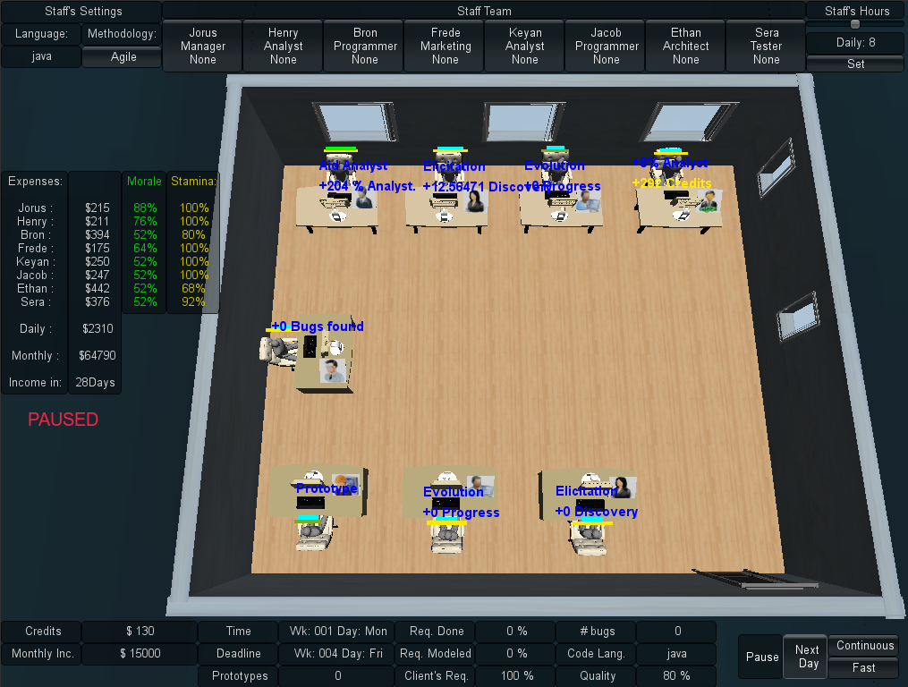
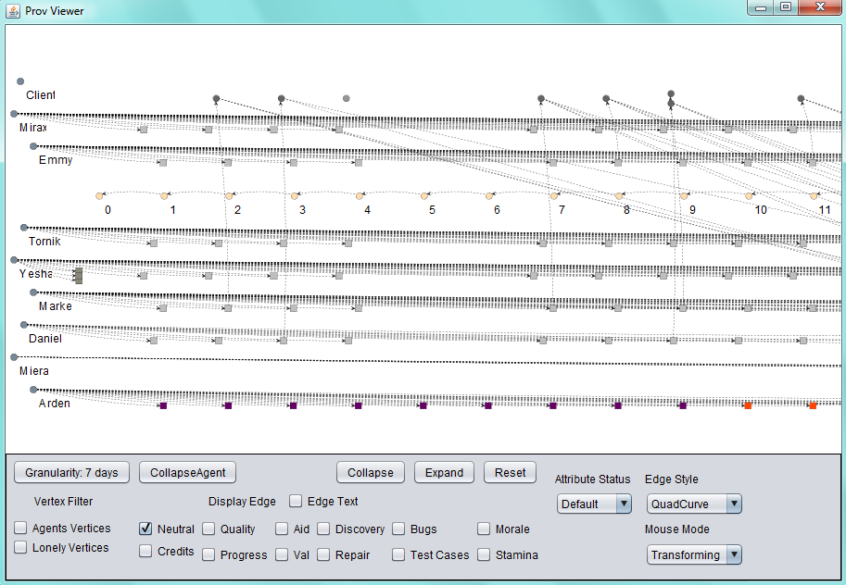
Evaluation
Case of Study
SDM: A Software Engineering Serious Game
Provenance Visualization
Prov Viewer

Slide 14
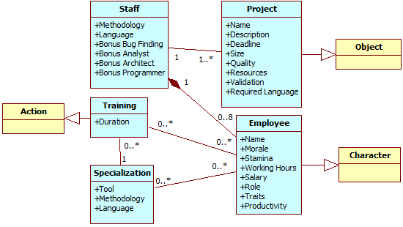
Case of Study
Notes:
SDM & Prov Gathering
Briefly explain SDM

Slide 15

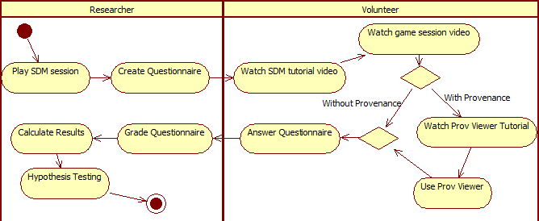
Experiment Plan
Notes:
Para avaliar a nossa abordagem, rodamos um experimento onde estudantes viam um vídeo referente a uma sessão de jogo e respondiam a perguntas quanto a esse jogo. Parte dos estudantes tinha acesso ao Prov Viewer e outra parte não. O intuito desse experimento era verificar o quanto a nossa abordagem auxilia no entendimento, em termos da precisão das respostas obtidas e da eficiência nessas respostas

Slide 16
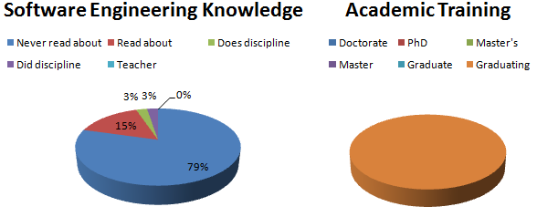
Experiment
37 Volunteers
5 dropped out

Slide 17
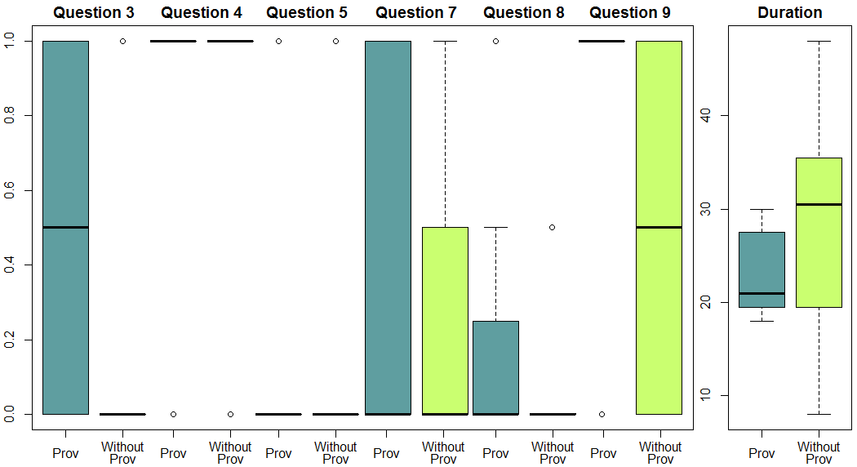
Experiment Results
 |  | Q3 | Q4 | Q5 | Q6 | Q7 | Q8 | Q9 | Duration (Minutes)
With Prov | Mean | 0.5 | 0.9375 | 0.1875 | 0 | 0.375 | 0.1562 | 0.8125 | 23.1875
 | Standard Deviation | 0.5164 | 0.25 | 0.4031 | 0 | 0.5 | 0.3010 | 0.4031 | 4.2461
Without Prov | Mean | 0.0625 | 0.875 | 0.1875 | 0 | 0.25 | 0.0938 | 0.5 | 28.9375
 | Standard Deviation | 0.25 | 0.3416 | 0.4031 | 0 | 0.4472 | 0.2015 | 0.5162 | 10.5797
Notes:
Resultados superiores

Slide 18

Experiment Results
Mann-Whitney Test
H₀ : μ_{prov} = μ_{replay}
H₁ : μ_{prov} ≠ μ_{replay}
p-value < α: Reject null Hypothesis
α = 0.05 = 5%
α = 0.05 | Correctness |  |  |  |  |  |  | Time
 | Q3 | Q4 | Q5 | Q6 | Q7 | Q8 | Q9 | Duração
p-valor | 0.007259 | 0.5757 | 1 | Null | 0.467 | 0.6371 | 0.07049 | 0.03595

Slide 19

Threats to Validity
Internal
Group Division
Individual Perception
Volunteers are more motivated
First Contact with Game and Tool
External
Discrepancy in Experience
Mitigated by being in the same period and discipline
Construct
Lack of Knowledge
Mitigated by having 7 Questions exploring different aspects
Duration
Mitigated by controlling start and end time
Conclusion
Interpretation
Mitigated by explaining Questionnaire
Watched a video instead of playing

Slide 20

Conclusion
Presented New perspectives on Software Engineering Learning Process
Game provenance
Induce deeper Analysis
Induce discussions regarding the game session
Identify Cause-and-Effect Relationships
Game Provenance can also help on:
Confirming the hypotheses formulated by students
Supporting tutors for a better guidance
Motivating practical exercises around some case studies
Extracting behavior patterns from individual sessions or groups of sessions

Slide 21


Research Questions
Provenance Analysis
Help to understand events that emerged during the game?
Yes. Helped to understand the underlying influences.
Is faster than only watching a replay of the game session?
Yes, even when using the tool for the first time.
Is more accurate than only watching a replay of the game session?
Yes. It provides equal or more accurate answers.

Slide 22


Future Work
Graph
Layouts
Inference
Game module for Provenance Gathering
Easier integration with other games
More Experiments!

Slide 23
Reinforcing Software Engineering Learning Through Provenance
Troy C. Kohwalter
Esteban W. G. Clua, Leonardo G. P. Murta
Instituto de Computação – Universidade Federal Fluminense (UFF)

